Slide 1

Software Testing
Sana Rizwan
Assistant Professor
Department of Computer Science, CUI Lahore

Slide 2
Chapter 2 – Fundamentals of Testing

Slide 3
Define Software Testing
Process of exercising or evaluating a system or system component by manual or automated means to verify that it satisfies specified requirements.
Process of analyzing a system to detect the difference between existing and required conditions and to evaluate the features of the system.
Process of executing a program or part of a program with the intention of finding errors.
Verifying if the software behavior is as expected.

Slide 4
Case Study
A car manufacturer develops a new electronic sales support system called Virtual ShowRoom (VSR).
The final version of this software system will be installed at every car dealer worldwide. Customers who are interested in purchasing a new car will be able to configure their favorite model (model, type, color, extras, etc.), with or without the guidance of a salesperson.
The system shows possible models and combinations of extra equipment and instantly calculates the price of the car the customer configures.
A subsystem called DreamCar will provide this functionality.
When the customer has made up her mind, she will be able to calculate the most suitable financing (EasyFinance) as well as place the order online (JustInTime).
She will even get the option to sign up for the appropriate insurance (NoRisk).
Personal information and contract data about the customer is managed by the ContractBase subsystem.

Slide 5
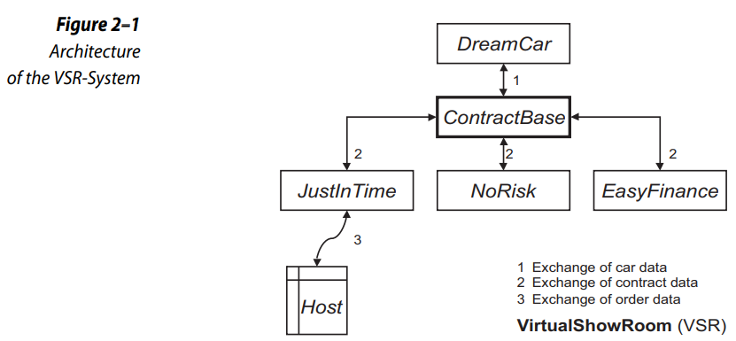
Case study
Every subsystem will be designed and developed by a separate development team. Altogether, about 50 developers and additional employees from the respective user departments are involved in working on this project. External software companies will also participate.
The VSR-System must be tested thoroughly before release. The project members assigned to test the software apply different testing techniques and methods.

Slide 6
Software need
During the construction of an industry product, the parts and the final product are usually examined to make sure they fulfill the given
➞Requirements -- product solves the required task.
Depending on the product, there may be different requirements to the ➞quality of the solution.
If the product has problems, corrections must be made in the production process and/or in the design of the product itself.
Solution:
Testing of partial products and the final product is more difficult, because a software product is not a tangible physical product. Direct examination is not possible. The only way to examine the product is by reading (reviewing) the development documents and code.

Slide 7
Software need
The dynamic behavior of the software, however, cannot be checked this way.
➞testing -- executing the software on a computer.
Its behavior must be compared to the requirements. It contributes to reducing the
➞risk of using the software
➞defects can be found in testing
Testing and test documentation are often defined in contracts, laws, or industrial or organizational standards.

Slide 8
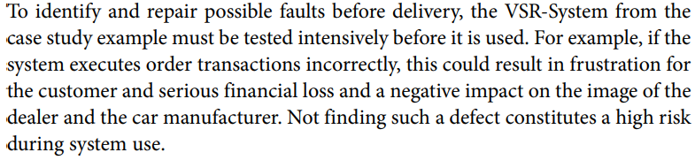
Example

Slide 9
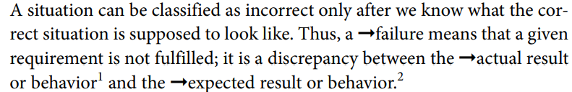
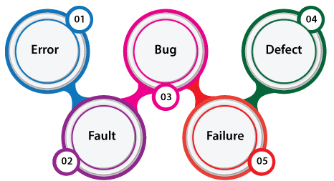
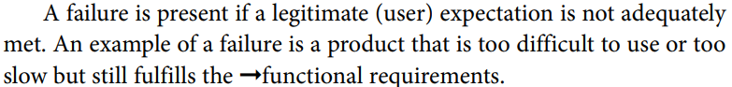
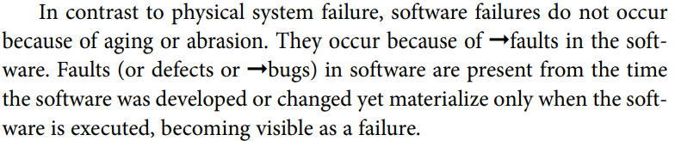
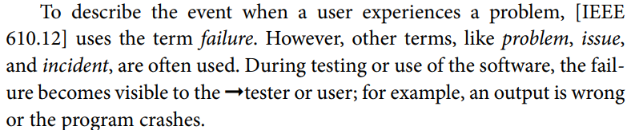
Error, Defect, and Bug Terminology

Slide 10
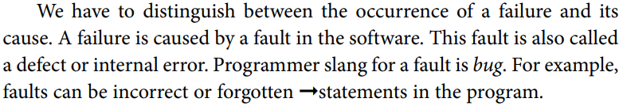

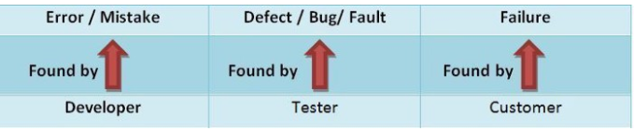
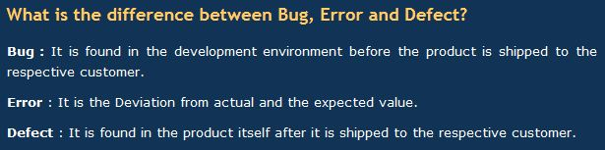


Error, Defect, and Bug Terminology

Slide 11
Testing is not debugging
To be able to correct a defect or bug, it must be localized in the software. Initially, we know the effect of a defect but not the precise location in the software. Localization and correction of defects are tasks for a software developer and are often called
➞debugging. Repairing a defect generally increases the
➞quality of the product
➞change in most cases does not introduce new defects.
Unwanted side effects make testing more difficult. The result is that not only must we repeat the
➞test cases that have detected the defect, we must also conduct even more test cases to detect possible side effects.

Slide 12
A test is a sample examination
Debugging is often equated with testing, but they are entirely different activities.
Debugging is the task of localizing and correcting faults.
The goal of testing is the (more or less systematic) detection of failures (that indicate the presence of defects).
A test is a sample examination Every execution (even using more or less random samples) of a
➞test object in order to examine it is testing.
Comparing the actual and expected behaviors of the test object serves to determine if the test object fulfills the required characteristics.

Slide 13
Software testing purpose
■ Executing a program to find failures
■ Executing a program to measure quality
■ Executing a program to provide confidence
■ Analyzing a program or its documentation to prevent failures
Besides execution of the test object with ➞test data, planning, design, Testing terms implementation, and analysis of the test (➞test management) also belong to the ➞test process.
A ➞test run or ➞test suite includes execution of one or more ➞test cases. A test case contains defined test conditions.
These are the preconditions for execution, the inputs, and the expected outputs or the expected behavior of the test object.
A test case should have a high probability of revealing previously unknown faults.
Several test cases can often be combined to create ➞test scenarios

Slide 14
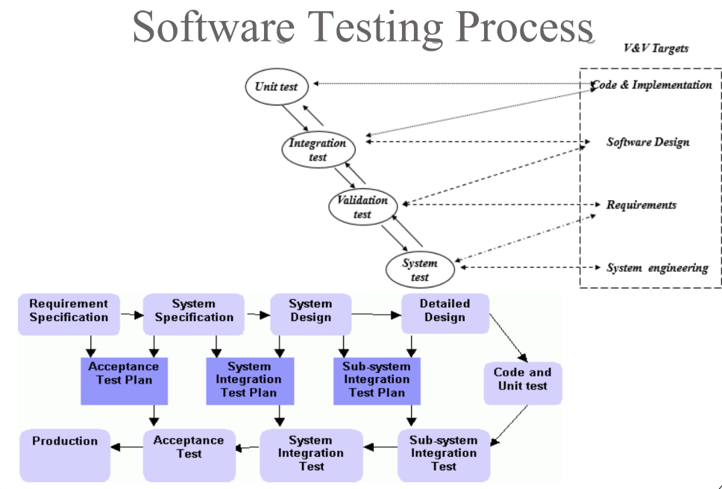

Slide 15
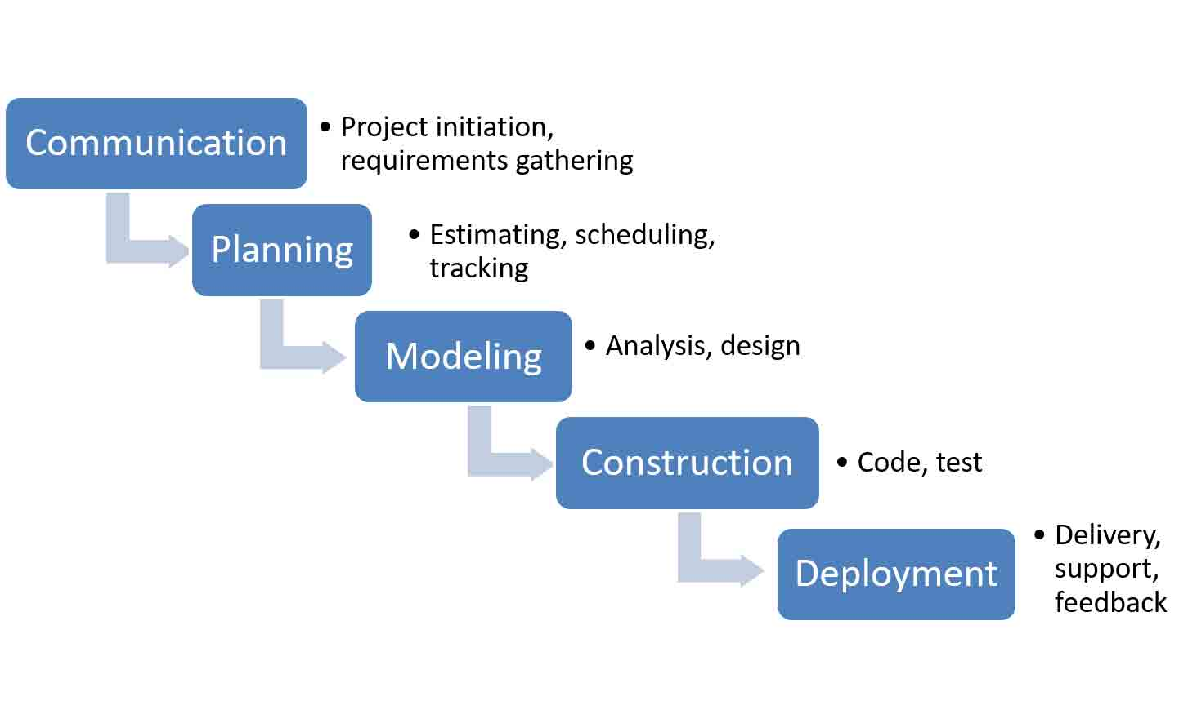
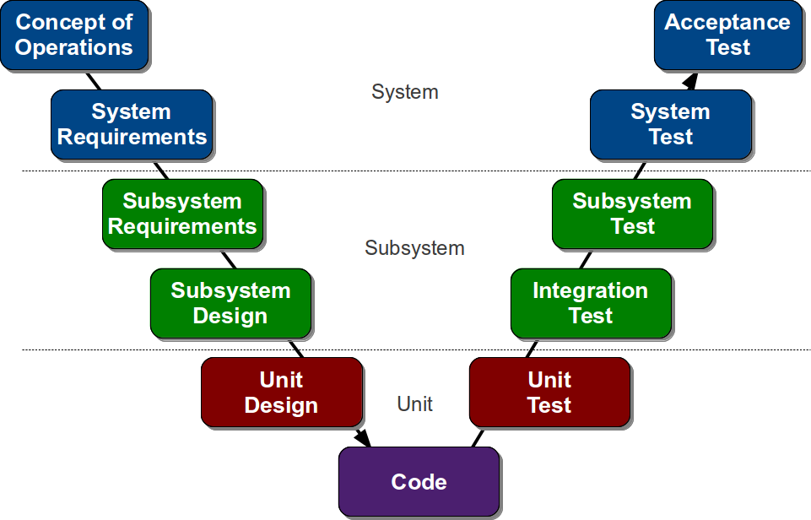
Waterfall Process Model
V- Model

Slide 16

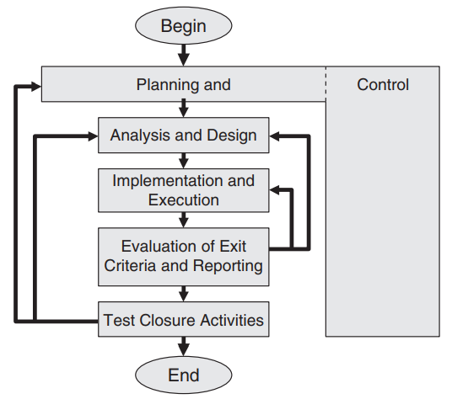
Generic Test Process
Description of tasks in the process models is not sufficient as an instruction on how to perform structured tests in software projects. In addition to embedding testing in the whole development process, a more detailed process for the testing tasks themselves is needed.
Activities in the test process may overlap or take place concurrently.
Test activities also need to be adjusted to the individual needs of each project.

Slide 17
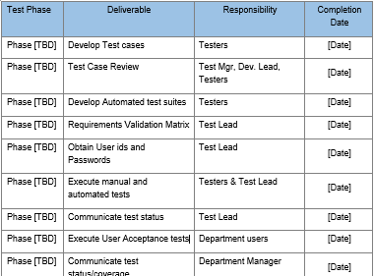
Test Plan
Planning of the test process starts at the beginning of the software development project.
During the course of the project the previous plans must be regularly checked, updated, and adjusted.
Which employees are needed for the execution of which tasks and when?
How much time is needed, and which equipment and utilities must be available?
These questions and many more must be answered during planning, and the result should be documented in the ➞test plan

Slide 18
Test Plan Example – Case study
SIT Testing Template (System Integration Testing) | PractiTest
Writing a test plan is typically a test management or leadership responsibility. Others on the test team and in the organization (such as users and developers) may have input and review tasks, but it is generally up to the manager to actually write the test plan.
A great starting point in creating a test plan is the definition of a test strategy. A software test strategy helps in understanding the broad objectives of the test and how a particular project or release is unique. With a test strategy in place, now it is ready to start creating a test plan.
It is typical to have gaps and vagueness in the first draft of a test plan. Many times, the information needed in a test plan will emerge over time. In fact, there may be some details of the test that do not become clear until shortly before the test. For example, details such as the features to be tested may be changing even up to the time of release.
As you write the test plan, you will discover that the writing effort becomes one of investigation as you seek to learn the details needed in the plan. A good practice is to assign certain parts of the test plan to members of the test team to investigate and document. As the author of the test plan, you can then compile and edit the information.
Perhaps one of the most important tasks in creating the test plan is to review it. The first review should be a team review involving members of the test team with knowledge of the content.
After making any needed changes, the next review should involve knowledgeable stakeholders such as project leaders, test team leaders, technical test analysts, business analysts, subject matter experts and any other people that can provide helpful perspectives in the review.

Slide 19
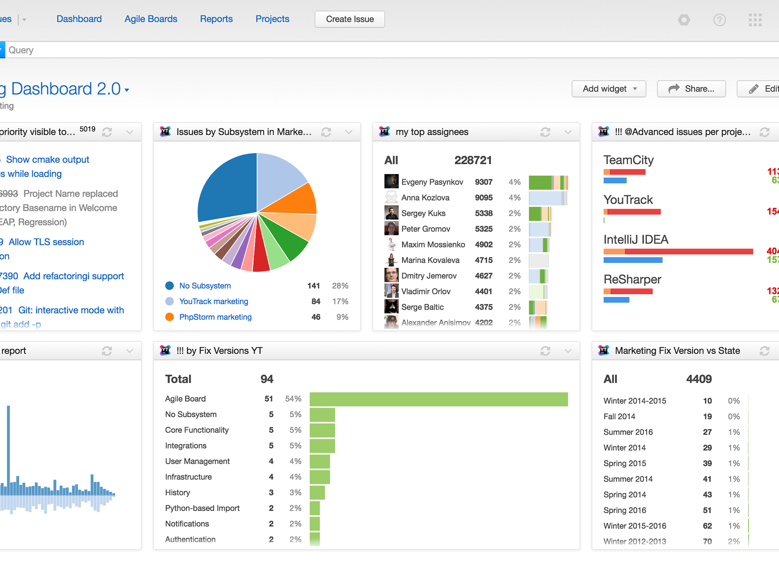
Test control
Test control is the monitoring of the test activities and comparing what actually happens during the project with the plan.
It includes reporting the status of deviations from the plan and taking any actions necessary to meet the planned goals in the new situation.
The test plan must be updated to the changed situation.
Test management tasks -- administrating and maintaining the test process, the test infrastructure, and the testware.
Progress tracking can be based on appropriate reporting from the employees as well as data automatically generated from tools.

Slide 20
Test strategy
Exhaustive test is not possible.
Priorities must be set based on risk assessment.
The test activities must be distributed to the individual subsystems, depending on the expected risk and the severity of failure effects.
Critical subsystems must get greater attention, thus be tested more intensively.
For less critical subsystems, less extensive testing may be sufficient. If no negative effects are expected in the event of a failure, testing could even be skipped on some parts.
Goal
The goal of the test strategy is the optimal distribution of the tests to the “right” parts of the software system

Slide 21
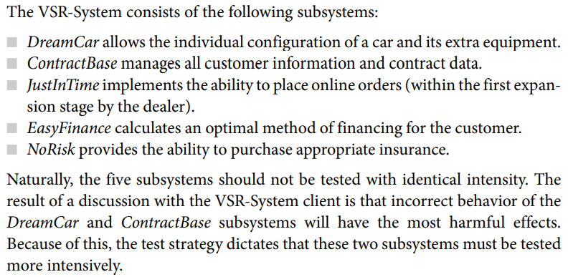
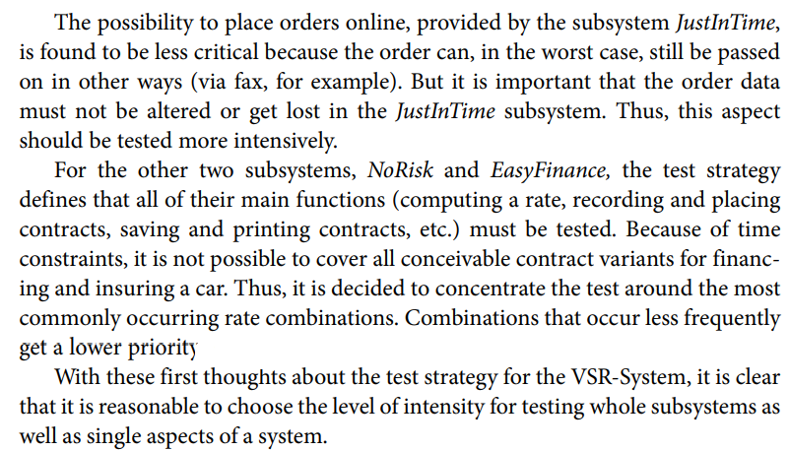
Example of test strategy

Slide 22
Test coverage
The intensity of testing depends very much on the test techniques that are used and the ➞test coverage that must be achieved.
Test coverage serves as a test exit criterion. Besides ➞coverage criteria referring to source code structure (for example, statement coverage).
Define meeting the customer requirements as an exit criterion.

Slide 23
Test analysis and design
Test basis -- specification of what should be tested. The basis for the creation of a test can be the specification or architecture documents, the results of risk analysis, or other documents produced during the software development process.
Check Testability -- checking the ease with which interfaces can be addressed (interface openness) and the ease with which the test object can be separated into smaller, more easily testable units. These issues need to be addressed during development and the test object should be designed and programmed accordingly.
Consider the Risk -- test strategy is dependent on requirements for reliability and safety. If there is a high risk of failure for the software, very thorough testing should be planned. If the software is less critical, testing may be less formal.
Traceability -- between the specifications to be tested and the tests themselves. It must be clear which test cases test which requirements and vice versa. Only this way is it possible to decide which requirements are to be or have been tested, how intensively and with which test cases.

Slide 24
Test case specification
Logical Test Cases
Black box testing
White box testing
Concrete Test Cases
Test Specification
Negative Test
Test execution
Test Process
Pre-condition
Exception Handling
Test Oracle
Test Results

Slide 25
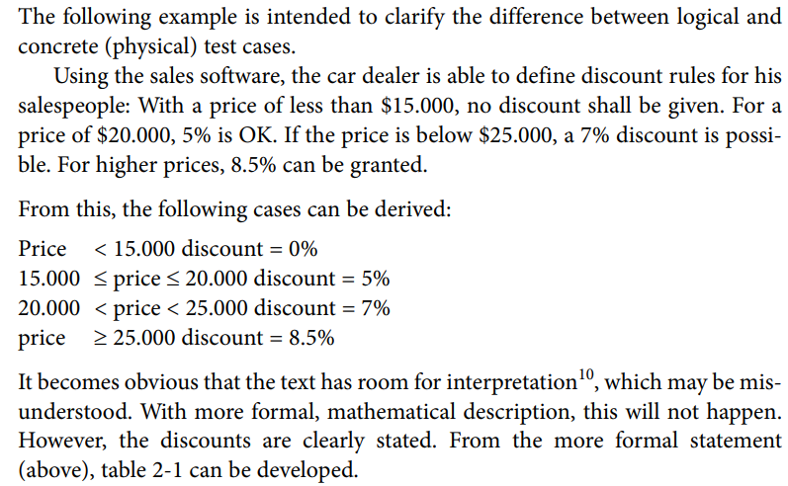
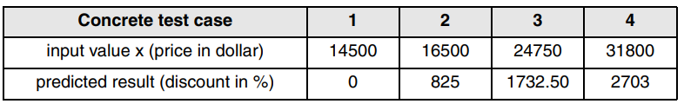
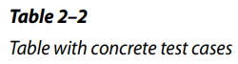
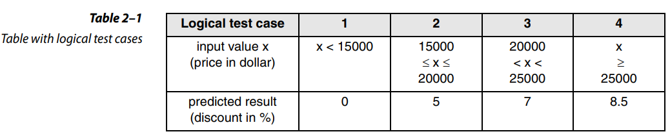
Test case (logical and physical) example

Slide 26
Test implementation and execution
Logical test cases must be transformed into concrete test cases
All the details of the environment (test infrastructure and test framework) must be set up.
The tests must be run and logged.
test cases can then be used without further modifications or additions for executing the test, if the defined preconditions for the respective test case are fulfilled.
The mutual traceability between test cases and specifications must be checked and, if necessary, updated.
Priority of the test cases will decide during test planning.
If the test developer executes the tests himself, additional, detailed descriptions may not be necessary.
Test cases should also be grouped into test suites or test scenarios for efficient test execution and easier understanding.

Slide 27
Test harnesses
➞drivers
➞simulators
must be programmed, built, acquired, or set up as part of the test environment before the test cases can be executed. Because failures may also be caused by faults in the test harness, the test environment must be checked to make sure it’s working correctly.
Checking for completeness
Test object is installed in the available test environment and tested for its ability to start and do the main processing.
Examination of the main functions
The recommendation is to start test execution with the examination of the test object’s main functionality (smoke test). If failures or deviations from the expected result show up at this time, it is foolish to continue testing.
Tests without a log are of no value
Test execution must be exactly and completely logged. This includes logging which test runs have been executed with which results (pass or failure).
Reproducibility is important
The information related to a test case or test run must be maintained in such a way that it is possible to easily repeat the test later with the same input data and conditions. The testware must be subjected to configuration management.
Failure found
If a difference shows up between expected and actual results during test execution, it must be decided when evaluating the test logs if the difference really indicates a failure. If so, the failure must be documented. At first, a rough analysis of possible causes must be made. This analysis may require the tester to specify and execute additional test cases.

Slide 28
Test evaluation and reporting
Test object is assessed against the set test exit criteria specified during planning.
This may result in normal termination of the tests if all criteria are met, or it may be decided that additional test cases should be run or that the criteria were too hard.
For-example: , A test is considered good enough after execution of 80% of the test object statements. However, this would not be a very high requirement for a test. Appropriate tools should be used to collect such measures, or metrics, in order to decide when a test should end.

Slide 29
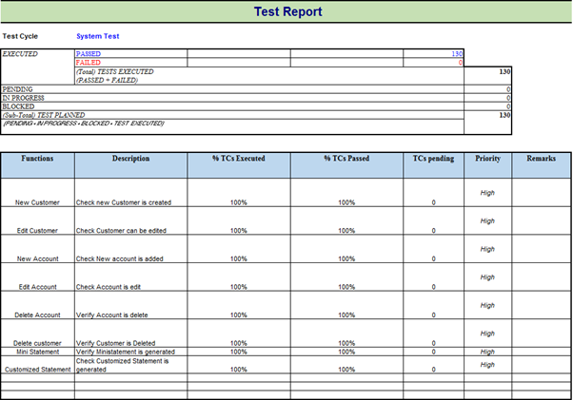
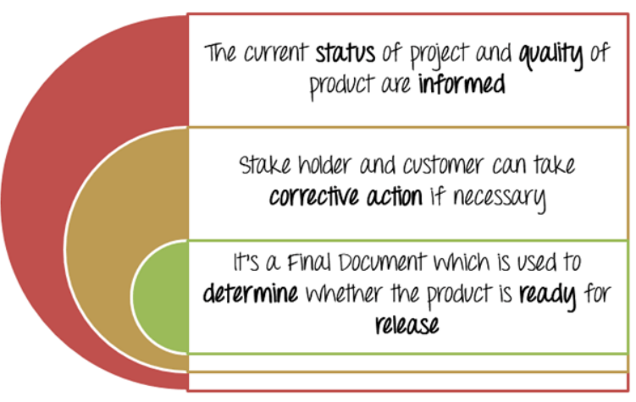
Test Report is a document which contains a summary of all test activities and final test results of a testing project. Test report is an assessment of how well the Testing is performed. Based on the test report, stakeholders can evaluate the quality of the tested product and make a decision on the software release.
For example, if the test report informs that there are many defects remaining in the product, stakeholders can delay the release until all the defects are fixed.
Typical Benefits of Test Report

Slide 30
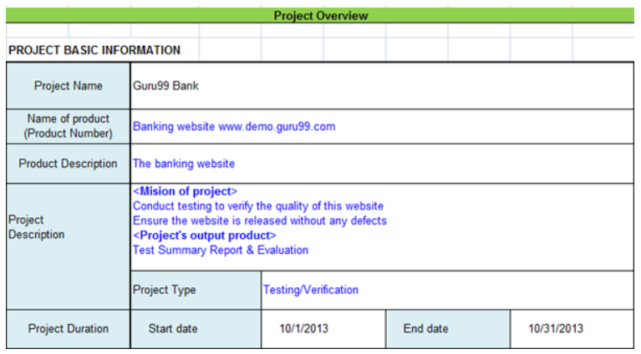
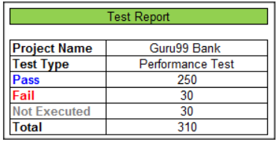
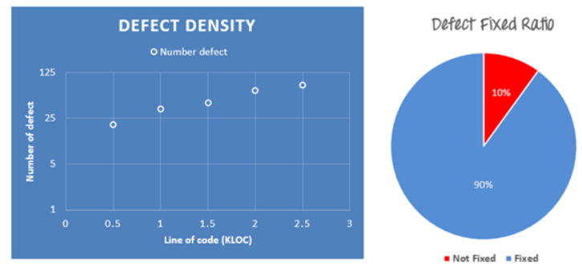
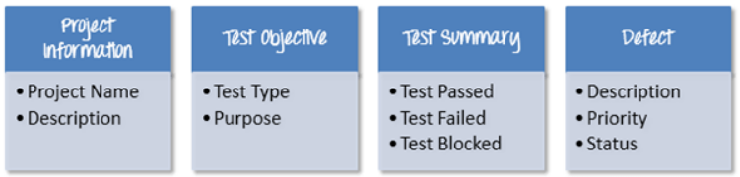
Information in Test Report is defect
Total number of bugs
Status of bugs (open, closed, responding)
Number of bugs open, resolved, closed
Breakdown by severity and priority
The project team sent you the Defect information as following;
Defect density is 20 defects/1000 lines of code average
90% defects fixed in total
The detail of the bugs are described in this Defect tracker
Structure of Project Report

Slide 31
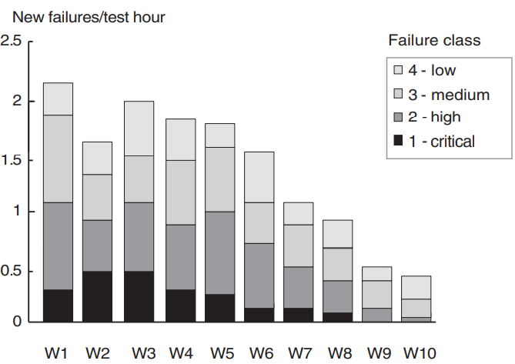
Failure Rate

Slide 32
Test closure activities
After test execution phase is declared finished, the important outputs should be captured for archiving or conveying to the concerned person.
Together these tasks form the test closure activities, which fall into these four key groups:
1. Checking for completion of tests-- All known bugs must be corrected, deferred, or acknowledged to be permanent limitations. In case of bug correction, the corrections must be tested as well.
2. Handing over test objects -- The relevant work products must be passed on to the relevant people. For instance, known bugs must be conveyed to the system maintenance team.
3. Learning Experience -- Discuss and document lessons learned from the testing as well as the complete SDLC.
4. Archiving -- Test documents like test reports and logs and work products must be archived in configuration management system. They are usually missed by the testing teams. So, they must be clearly built into the test plan.

Slide 33
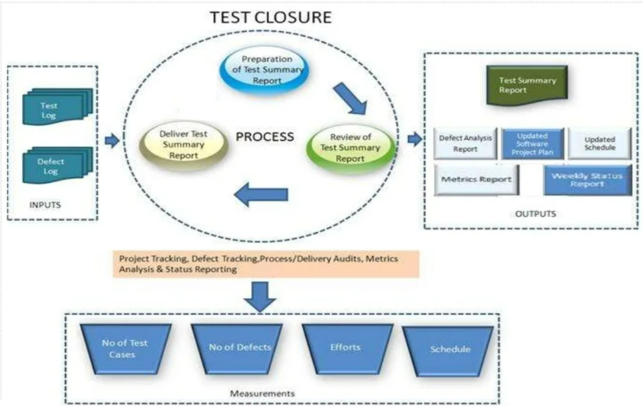

Slide 34
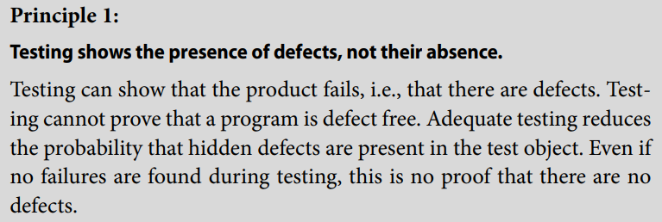
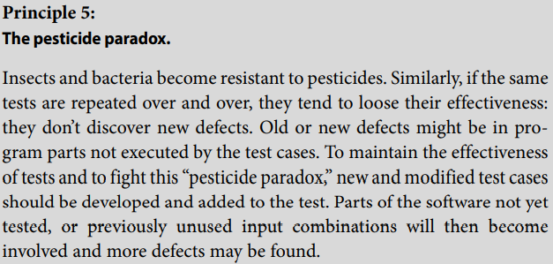
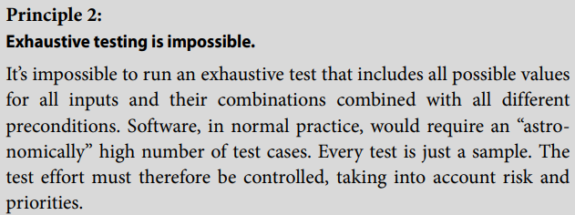
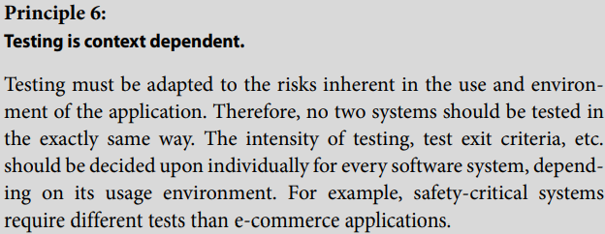
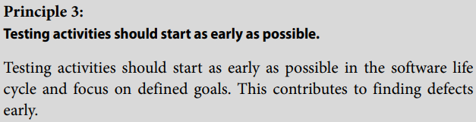
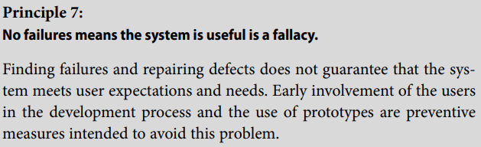
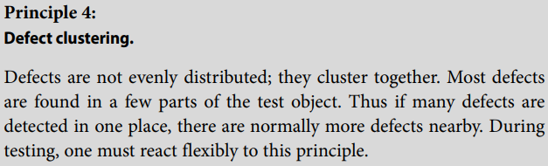
General Principles of testing

Slide 35
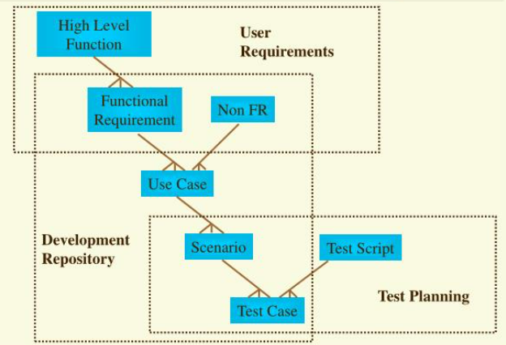
Software testing lifecycle traceability

Slide 36
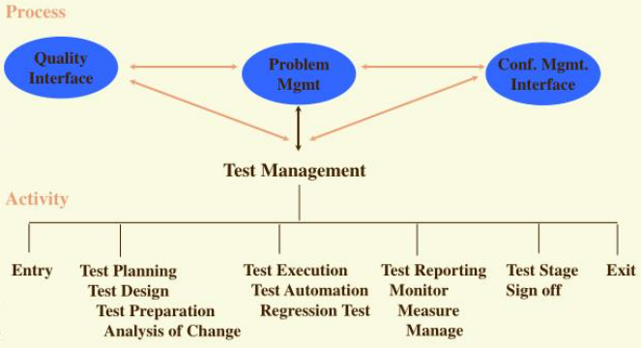
Testing process and activities

Slide 37
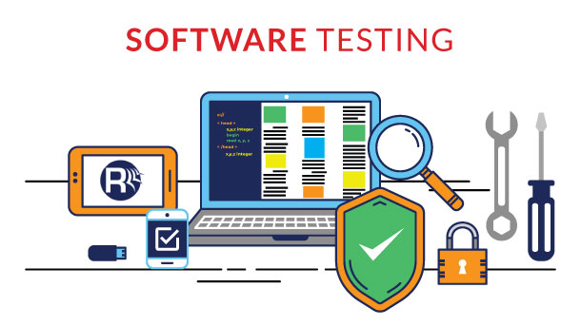

Any Questions

